Slide 2
APIs as Products
Ash Owen
2/12/2020

Slide 3
What we will cover
Where’s your API today
What’s happening to APIs
Building API Products
Question: How can you realize more value for your APIs?

Slide 4


About me
Award winning global development strategist
Proven ability to capitalize on market opportunities
Product Management and Marketing Leader
Passionate about sports…

Slide 5
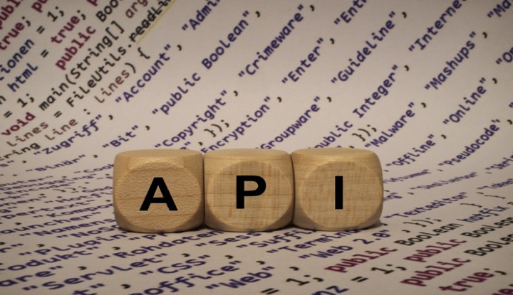
Notes:
Companies have wholeheartedly embraced APIs as a way to expose business capabilities to both external and internal developers. APIs promise the ability to experiment quickly with new business ideas by recombining core capabilities. But what differentiates an API from an ordinary enterprise integration service? One difference lies in treating APIs as a product, even when the consumer is an internal system or fellow developer. Teams that build APIs should understand the needs of their customers and make the product compelling to them. Usability testing and UX research can lead to a better design and understanding of the API usage patterns and help bring a product mindset to APIs. APIs, like products, should be actively maintained and supported, and, easy to use. They should have an owner who advocates for the customer and strives for continual improvement. In our experience, product orientation is the missing ingredient that makes the difference between ordinary enterprise integration and an agile business built on a platform of APIs.

Slide 6
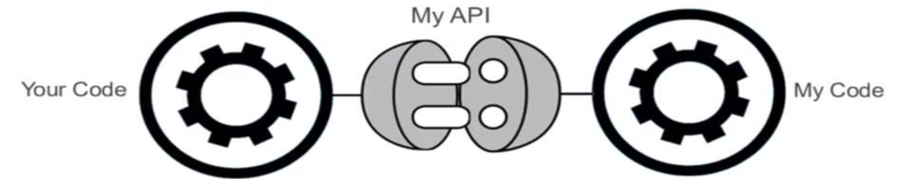
What is an api in a business context
Essentially a contract between providers and consumer describing the terms of the functionality the API will offer
The contract increases confidence, which increases use
APIs can be open to developers, partners or used internally
Contract makes connection efficient as interfaces are documented, consistent & predicable
Contract is binding and cannot be changed casually
Notes:
APIs are the way software talks to other software – so by definition they’re a technology that connects systems,. But APIs are much more. They’re interfaces that enable developers to repeatedly leverage data, functions and applications to build new products and services. They’re how a business expresses itself via software, and they enable that business to rapidly expand into new contracts or adapt to meet changing user needs and preferences.
APIs aren’t just some back office technical detail – they’re both the products for the developers that build today’s customer experiences and the mechanisms through which value is increasingly exchanged in modern economies. In recent years, Salesforce has generated half its revenues through APIs. For eBay, the figure has been 60 percent, and for Expedia, an astonishing 90 percent. The number of public APIs has grown exponentially, from a few hundred in 2005 to more than 19,500 in Spring 2018. Stories such as these are why many of talk about an API economy.

Slide 7
Building blocks of an api contract
Definition
Terms of Service
Privacy
Service Level Agreements
Service Accord
Interface License
Data license
Code License
Depreciation
Roadmap
Change Log
Rate Limits
Uptime/Availability
Pricing
Service Tiers
Support
Notes:
In the last few years, with the increase use of API definition formats like API Blueprint, Swagger, and RAML, we often reference this API definition as a tangible representation of the contract API providers and consumers enter into. However, I see the API definition as one building block, in a larger set of building blocks, that are working together to form a contract, with the API definition acting as the truth. So what might contribute to the overall API contract, negotiated between API provider and consumer, starting with the API definition
Definition – a common way to describe, communicate and collaborate around APIs, which are often extremely abstract
Terms of Service –determining how the service can be used, allowing consumers to quickly understand where they stand
Privacy - The privacy of a platform, is definitely a very critical element of the API contract and sets the tone.
Service Level Agreement – sets the quality of service expectations within the API contract
Service Accord – if you can’t offer a formal SLA, provide a service accord with users, setting expectations around level of service
Interface Licensing – whether you apply copyright, or some other license, and API license will be part of the contract
Data License – the licensing of underling data stored, and returned by an API needs to have a license define, pending guidance from consumers
Code License – Providing code in the form of samples, libraries, and SDKs
Deprecation Policy – How long can API consumers depend on an API? What sort of notification is provided before it is deprecated.
Roadmap – API contracts are considered to be open ended, and there is an obligation to communicate API roadmap
Changelog – providing a place where API consumers can see a recent history of changes to an API
Rate Limits – As an API consumer I need to know how my contract will scale
Uptime/Availability –
Pricing –
Service tiers –
Support -

Slide 8
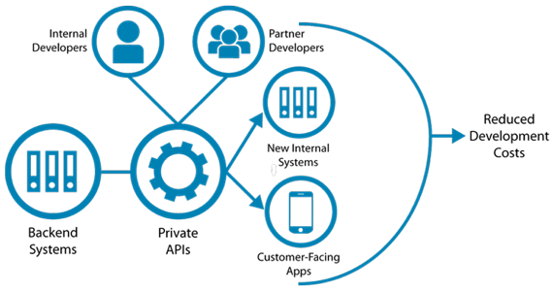
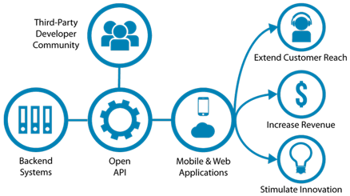
Types of API
Strategic Value
Innovation
Agility/Flexibility
Efficient programming/infrastructure
Private API
Strategic Value
Reach New Customers
Drive Brand Awareness
Unlock value of data
Public API
Notes:
One of the key considerations that should guide your API business strategy and your interface architecture is the distinction between open and private APIs. An interface is defined as open or private depending on whether it targets external or in-house developers.
Private APIs can significantly reduce the development time and resources needs to integrate internal IT systems, build new systems that maximize productivity and create customer-facing apps that extend market reach and add value to existing offerings. Rather than create siloed applications from scratch, devs can draw from a common pool; of internal software assets.
An open API can be used both by developers inside the organization that published the API or by any developers outside who wish to register for access to the interface. An open API publisher is seeking to leverage the ever growing community of ISVs, OEM partners and solution developers

Slide 9
ISV Partner - hybrid
Used to provide access to data with a trusted business partner
Strategic Value:
Collaboration
Value Add
New Revenue Channel
Partner

Slide 10
Business benefits of internal apis
Private APIs are more prevalent
Commence the API Strategic Journey
Modern organizational; structure
Improve collaboration and internal communication
Speed time-to-market
More efficiently manage the supply chain
Allow more precise business intelligence analytics
Notes:
Internal or private APIs can offer substantial benefits in efficiency and productivity. A study by the McKinsey Global Institute estimates that companies can increase their productivity by 20 to 25 percent by improving internal collaboration: a strategy that is only possible with the use of APIs

Slide 11
What is happening – a perspective
“APIs make Digital Society and Digital Business work by connecting people, business and things. Those connections enable new digital products and business models and create new business channels”
“Put APIs at the Center of Your Digital Business Platform”, Gartner

Slide 12
What is happening – another perspective
“Enterprises with top priorities like changing their business models or accelerating digital business are up to twice as likely to be investing in APIs and microservices”
“Microservices and APIs Underpin Digital Business”, Forrester

Slide 13
Integrations vs API products
Integrations - Supply side thinking
API Product - Demand side thinking
Asset oriented
Project
Tightly coupled integration
Finite resources (sized for the unknown)
System of function oriented
Composable processes
Monolithic systems
Integration as required
Horizontal teams
Consumer oriented
Continually Managed Product
Self-service consumable
Elastic infinite resources
Productized digital resources
Composable processes
Microservices
API as a product channel;
Multi-functional teams

Slide 14
Considerations for building API products

Slide 15
1. Start with the consumer in mind
Design Thinking
Definition: The design-thinking ideology asserts that a hands-on, user-centric approach to problem solving can lead to innovation, and innovation can lead to differentiation and competitive advantage.

Slide 16
Notes:
Invent a future for your customers.
Why is Design Thinking important: It can help you or your team surface unmet needs of the people you are creating for; it reduces the risk associated with launching new ideas; it generates solutions that are revolutionary, not just incremental and it helps organizations learn faster.
Empathy – understanding the needs of those you’re designing for
Ideation – Generation a lot of ideas. Brainstorming is one technique
Experimentation – Testing those ideas with prototyping

Slide 17
2. Manage like a product
Funded annually based on value derived
Has an API Product Manager
Multi-function team
DevOps Delivery

Slide 18
3. Manage the API Lifecycle and API Roadmap
Notes:
Full lifecycle API management involves all of the things it takes to get an API up and running and into the hands of developers, so that they can begin innovating and strat providing feedback to inform how the API is iterated upon over time. Though the numerous stages of the lifecycle may suggest a lengthy process: speed is the goal, so focus on MVPs that present core value proposition to developers and can be rapidly scaled or improved based on feedback.
Build APIs developers love and that are easy to use – Design according to RESTful best practices, focused on consumption and consistency, providing a clear value proposition the API represents to developers. Developers don’t have time learn inner workings of our systems, nor should they; they simply want the data to enrich their application.
Protect your APIs with a consistent set of security policies; test and deploy APIs with a modern agile, iterative SDLC, and automate testing and deployment

Slide 19
4. API versioning
When to Version
A change in the format of the response data for one or more calls
A change in the response type (i.e. changing an integer to a float)
Removing any part of the API
How to Version
URI Versioning
Versioning using a Custom Request Header
Versioning using Accept Header
Notes:
“Versioning is a crucial part of API design that gives developers the freedom to refactor their code and work on better representations for the resources of their API.” This is a straightforward way of versioning an API from an implementation point of view
URI Versioning: One way to version a REST API is to include the version number in the URL path.
Versioning through Custom Headers: REST APIs can also be versioned by providing custom headers with the version number included as an attribute.

Slide 20
5. Api strategy: business workflow oriented APIs
Targeted APIs are easier & quicker to build, expose less data up front, can be more easily valued, and support more specific use-cases meaning they are also easier to understand and consume
They also allow more targeted marketing
Some APIs might be free in order to “enable” the ecosystem and reduce friction / increase ease of interactions (data integration).
Data such as “technicians”, “skill codes”, etc., supporting data which adds little value other that enabling a flow will actually have significant value in making the platform “sticky”
Targeted APIs for various workflow integrations
Intake (lane)
Inspect
Repair Order
Appointment
Workshop management
Exposed data
Retained value

Slide 21
6. Adopt an API Mindset
 | Project Mindset | Product Mindset
Perspective | Inside-out | Outside-In
Goals | Completion | Consumption
Metrics | Compilation, Cost, Acceptance | Consumption, Revenue, Customer Satisfaction
Requirements | Exhaustive | Iterative
Teams | Intermittent | Continuous
Notes:
Outside-in: Obsession with the customer, data-driven, considers both developers - the API ’s direct customers and the end users those developers serve.
Customer focused, outside in focus: How often is the API called? What kind of calls are being made? Are developers changing their behaviour?
Define the right KPIs: to turn API consumption into actionable insights, connecting consumption to revenue Manage iterations: Once an API has been with developers for a short period, assess data to plan iterations
Consider monetization: Drive adoption by releasing APIs that give developers basic or full functionality at no cost. APIs that allow access to valuable data or functions are good candidates for monetization.

Slide 22
7. Cover roles/responsibilities of API Team
Role | Responsibility
The API Product Manager | Vision and Strategy
The API Architect | Drafts and Reviews
The API Developer | Build consumable APIs
The API Evangelist | Voice of API Consumers
The API Champion | Executive and LOB influencer
Notes:
The API Product Manager is responsible for putting cross-functional conversations and activities in place to help an organization develop its vision for API products; turning this vision ijto action by managing each stage of the API product lifecycle, prioritized by consumption data and other feedback from API consumers and customers.
The API Architect is responsible for planning, designing, and reviewing construction of APIs, designed for consumption rather than exposure.
The API Developer is the actual builder, bring the needs of the API consumer or application developer to fruition
The API evangelist is the voice of API consumers, a deep understanding of developers and what they need to be successful. Typically they manage the developer portal, ensuring access to information, including documentation, answering questions, running hackathons, attracting partners and collecting feedback.
The API champion connects APIs to their business value and provides metrics allied to company goals such as customer satisfaction

Slide 23
8. Self Service
Low bar to access
Easy to find
Well documented
Testable (TTFHW)
Requisitionable

Slide 24
9. Self-evident
Organization (taxonomy)
Categorization (collected by usage patterns)
Understandable vernacular
Simple structure
Common use of standard

Slide 25
10. Communicate
Marketed Awareness
Blog
FAQ
Chat/Support
Discussion Forums
Sample code
Push Notifications
Advisory Council

Slide 26
Summary
Treat your APIs as one of your value added products
Added value service for your customers
Monetization of new services through business models
Flexibility for future transitions
Additional revenue streams
What are your core business assets?
Customer data, Processes, Functionality, Content
Future business opportunities
Leverage core assets + External Services
Move fast, delight customers, and continually innovate API services

Slide 27
APIS AS PRODUCTS

